Slide 1
PRESENTATION
IoT FINAL PROJECT
Implement C Language Programming On GAP8
GUO Xiaofan
YIN Chenghao
18/12/2023

Slide 2
CONTENTS
01
Introduction
Realization
02

Slide 3
01
Introduction

Slide 4



Environment and Language
Ubuntu 22.4.03
C Language
GREENWAVE-GAP8

Slide 5
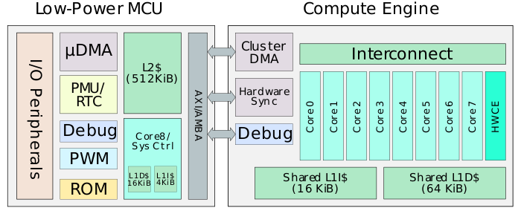
GAP8
Source: GAP8 – GreenWaves
Structure:
Autonomous Peripherals
Ultra-low Power Microcontroller
Compute Engine

Slide 6
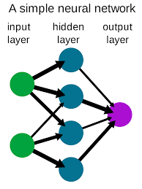
Neural Network
Input Layer
Directly process raw input data.
Hidden Layer
Processes data and extracts features.
Output Layer
Provides the final output of the network.
Source: Wikipedia

Slide 7
02
Realization

Slide 8
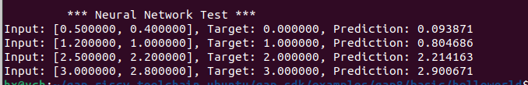
1. Realize a simple neural network
Objective:
Implement the simple neural network running in C.
Results : The program runs successfully(as shown in the picture).
Analysis:
The predicted value is quite close to the target value, indicating the training process is successful.

Slide 9
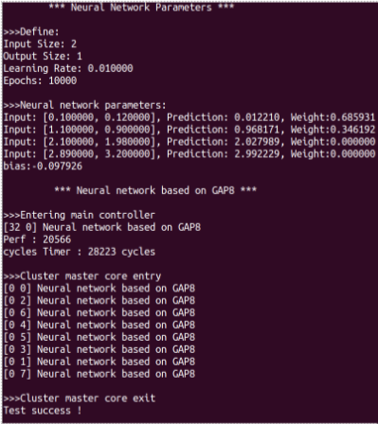
2. Implement the neural network on GAP8
Objective:
Deploy the neural network on the GAP8.
Results :
The program runs successfully
(as shown in the picture).
Analysis:
Neural network produce predictions close to the target value → the learning process is effective.

Slide 10
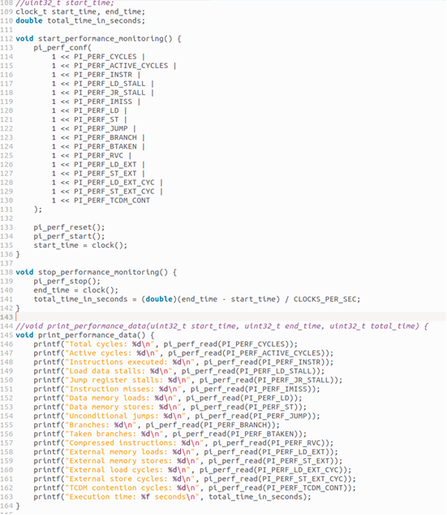
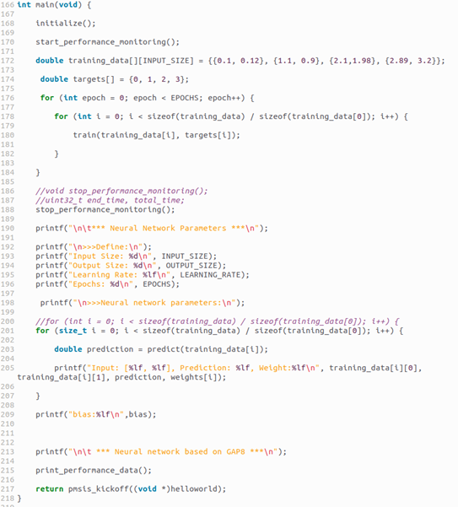
3. Implement NN on GAP8 with Performance counters
Objective: Add performance counters functions.

Slide 11
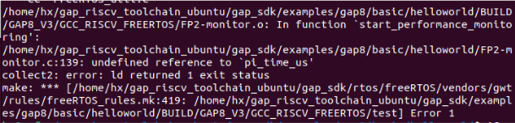
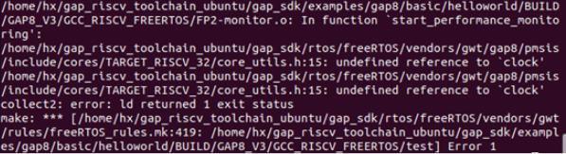
3. Implement NN on GAP8 with Performance counters
Problem: The time function cannot be called.
1) Using function of PMSIS “pi_time_us()”:
2) Using function of C language “clock ()” :

Slide 12
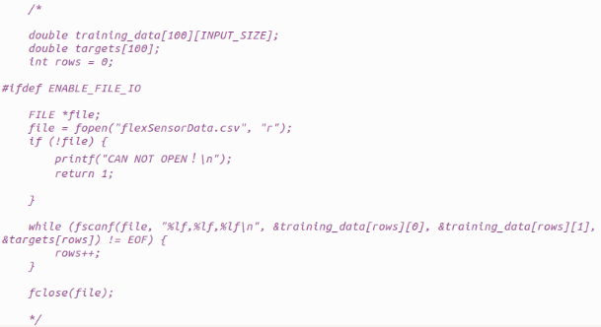
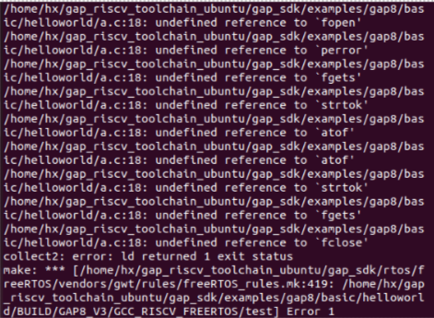
4. FlexSensorData Test
Objective:
Read the data in flexSensorData.csv for training the neural network.
Read Data:
Use the functions:
fopen(); fscanf(); fclose();
Problem:
The function could not be called accurately.
Solution:
Directly introducing the data into the neural network.

Slide 13
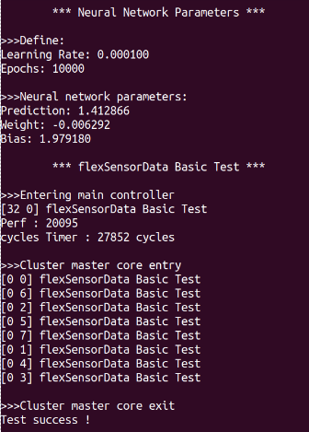
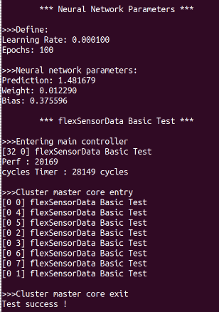
4-1. FlexSensorData Test
Results:
The program runs successfully
(as shown in the left picture).
Analysis:
The weights<0, bias >1, for input data the epochs value is large→ Consider overfitting.
Solution:
Reduce epochs.
Results:
The program runs successfully, weights>0, bias <1
(as shown in the right picture).

Slide 14
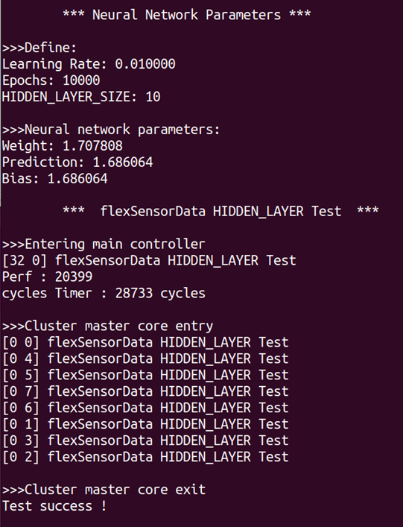
4-2. FlexSensorData Test with Hidden_Layer
Objective:
Considering the increase in the amount of input data and the complexity of the model compared to simple neural networks, try to create a multi-layer perception layer.
Results :
The program runs successfully
(as shown in the picture).

Slide 15
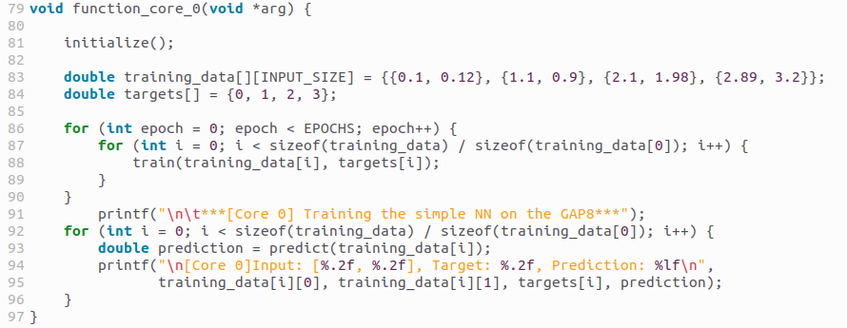
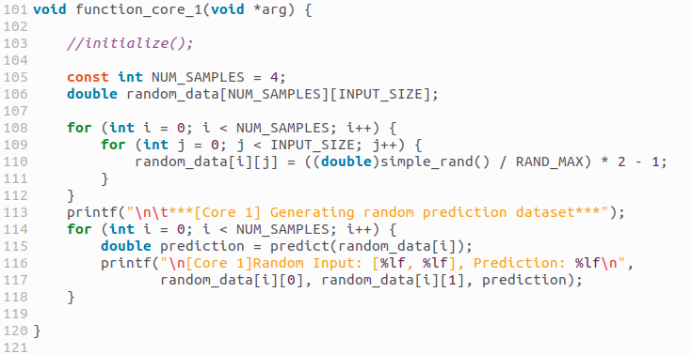
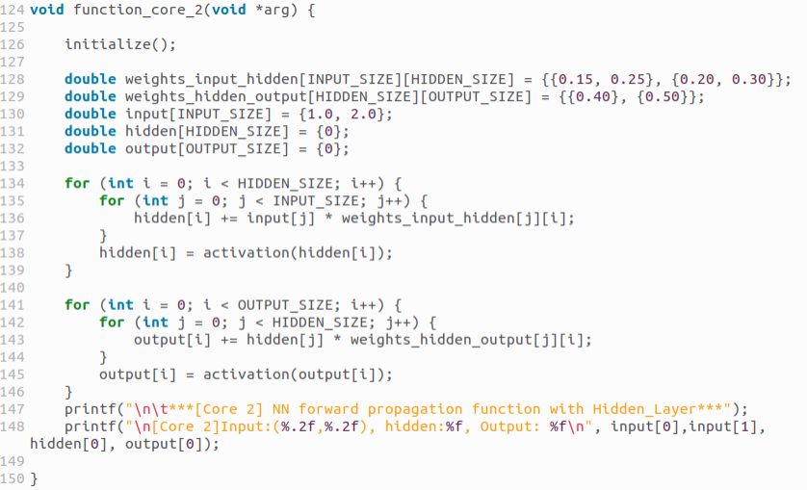
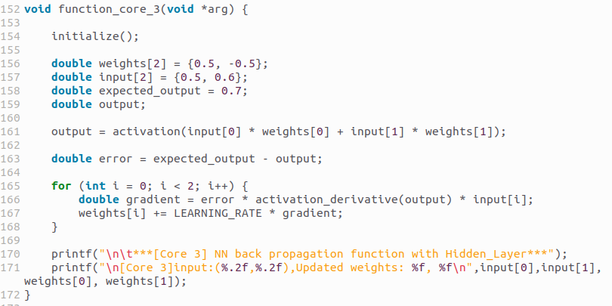
5. Multi-core asynchronous control
Core 1: Simple neural network
Core 2: Stochastic neural network
Core 3: Forward Propagation with Hidden Layer
Core 4: Back Propagation with Hidden Layer

Slide 16

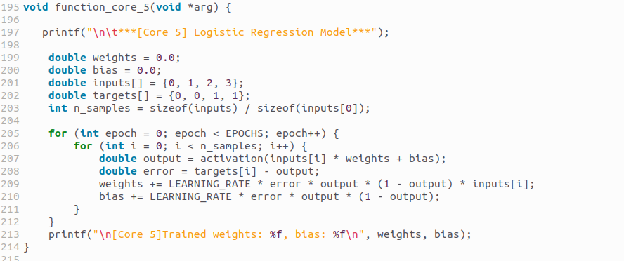

5. Multi-core asynchronous control
Core 5: Linear Regression
Core 6: Logistic Regression
Core 7: Multi-Layer Perceptron
Core 8: Simple Classification

Slide 17
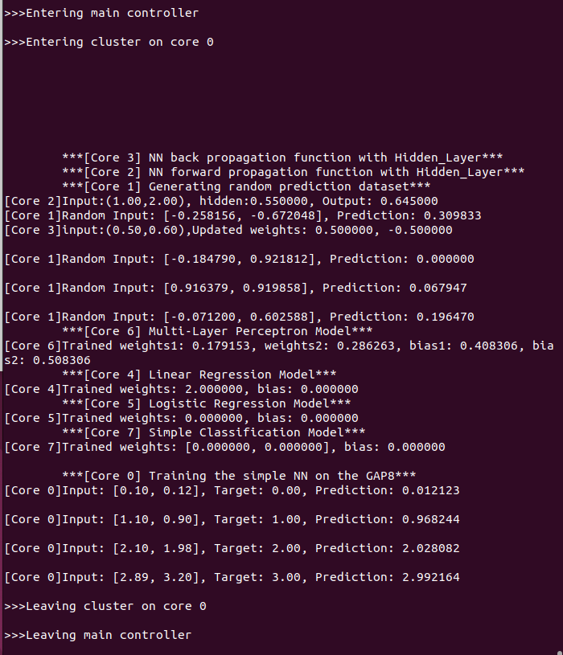
5. Multi-core asynchronous control
Results:
The program runs successfully
(as shown in the picture).
Analysis:
The titles and output results of different functions are mixed, this is because:
Each “function_core_n(void *arg)” is executed on a different core, but the outputs are redirected to the same standard output stream: Terminal.
The outputs are displayed consecutively in the order of execution, not in code order.

